Slide 1
One hidden layer
Neural Network
Vectorizing across
multiple examples
Notes:
Stacking examples in the column. With little modifications to the equations we learned previously we can get them working for neural networks as well.
Previously, we worked for 1 training example, here we will learn how we can do the operations to find a1 & than a2 for m training examples.

Slide 2


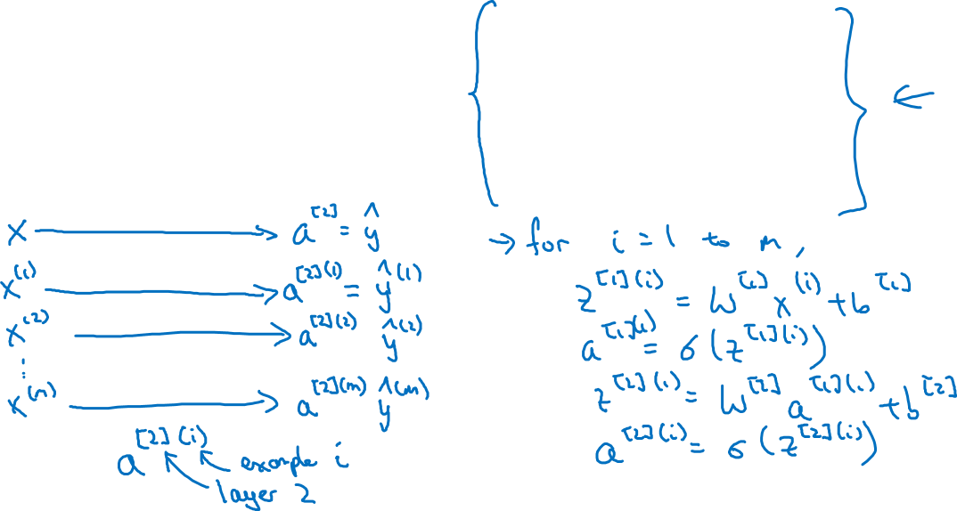



Vectorizing across multiple examples
$$z^{\left[1\right]}=W^{\left[1\right]}x+b^{\left[1\right]}$$
$$x_{1}$$
$$a^{\left[1\right]}=σ(z^{\left[1\right]})$$
$$x_{2}$$
$$\hat{y}$$
$$z^{\left[2\right]}=W^{\left[2\right]}a^{\left[1\right]}+b^{\left[2\right]}$$
$$x_{3}$$
$$a^{\left[2\right]}=σ(z^{\left[2\right]})$$
Notes:
For each training example, we will be producing a2 in short. We refer the training example with round bracket.
In a normal case, non vectorized version, we will be computing the 4 equations for each example with x being iterated over the examples.

Slide 3
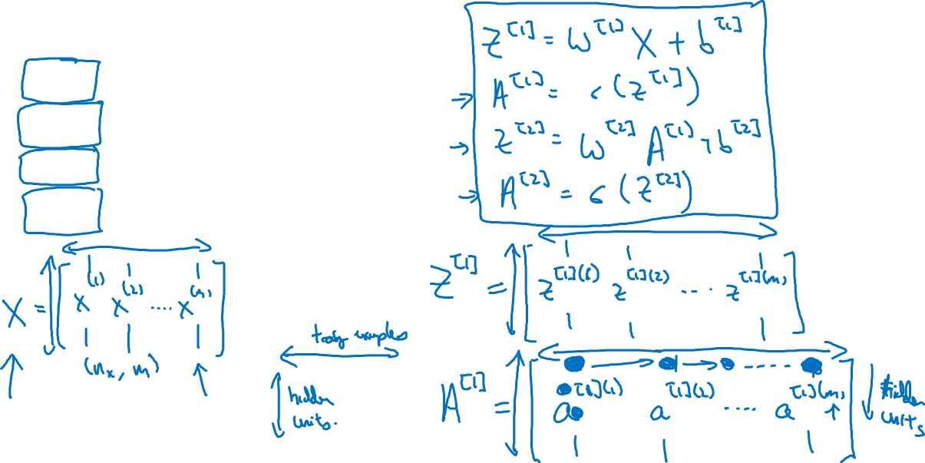




Vectorizing across multiple examples
for i = 1 to m:
$$z^{\left[1\right](i)}=W^{\left[1\right]}x^{(i)}+b^{\left[1\right]}$$
$$a^{\left[1\right](i)}=σ(z^{\left[1\right]\left(i\right)})$$
$$z^{\left[2\right](i)}=W^{\left[2\right]}a^{\left[1\right](i)}+b^{\left[2\right]}$$
$$a^{\left[2\right](i)}=σ(z^{\left[2\right]\left(i\right)})$$
Notes:
We stack our data examples in the column fashion like we have been doing it so far.
Than we want to find the value of Z1. This matrix is a column stacked version of smaller z values(calculated for each example of smaller x-data examples)
At a higher level, whenever, we are going from one layer to the next column stacking helps us.
Another notation, when we are moving from left to the right I Z, A matrices, the indexes move over the data examples.
Where as vertically, it moves over the number of nodes.
For example, the top left purple dot corresponds to the activation of first hidden unit on the first training example, when we go down the example remain the same but the activation unit is changing.
Similarly, in horizontal fashion activation number across the row is same & represents the hidden layer but the training examples move till m.
This holds for A, Z & as well as X.

Slide 4
One hidden layer
Neural Network
Explanation
for vectorized
implementation
Notes:
This is a justification of the equations we used previously for vectorizing across multiple examples.
This is the basis of vectorizing layers in hidden neural network. The key is understanding dimensions & matrix multiplications.

Slide 5
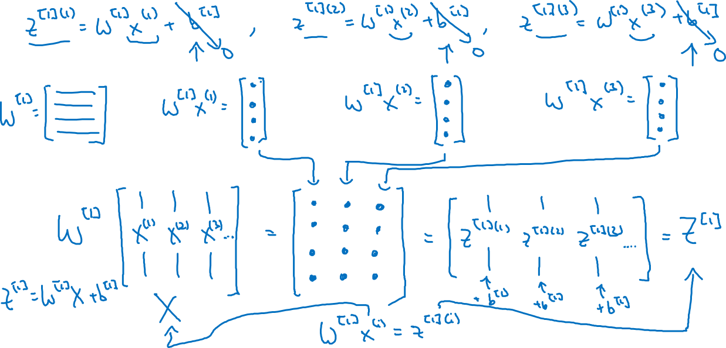
Justification for vectorized implementation
Notes:
Let us first go through the forward propagation part on example at a time.
How do we compute Z values for the first layer ?
Answer : Z values as we remember are the what goes into sigmoid function the linear combination, to compute these values we need inputs & weights associated with each input to the hidden layers.
Now, our X values are stacked in the columns with each column representing one training example. This matrix overall dimensions will be num of features X num of training examples or Nx by m.
How many weights are there ? Weights are associated with each feature in training example connection going to each node of hidden layer.
So if the number of features in each training example is alpha & the number of nodes in hidden layer is beta than we need alpha * beta number of weights. Here we have a W matrix for this task which keeps weights of each layer.
Now, one thing is common between this W matrix & our X matrix which is number of features. So we will use this notation for our understanding. & change the dimensions of W matrix in this way:
(Nx, num of hidden layers)
Now lets get back to the computation of Z.
For each Z, we want to compute the linear combination value, for this purpose, we take one training example & take its product with the weights associated.
We can however, use our matrices for this calculation & do this in a vectorized/matrix fashion.
For one training example, we take one column (feature values of that example) & multiply them with the corresponding weights, this is is shown in form of the purple example.
Dimension of our X matrix one example is ( Nx, 1 )
& the dimension of our weights for the layer is Nx by Num of hidden layers. I think we take transpose of this matrix, which will get us the order as Num of hidden layers, Nx
Now the product of these two matrices will get us one column of the order Num of hidden layers, 1
This way, all the weughts in the first layer gets multiplied with the current feature values & it results in z values.
We can do this for all the examples in similar & quick fashion by
W.T . X
The order of W.t will be Num of layers, Nx where as the order of X will be Nx, M
Resultant Z matrix will be of ortder Num of layers, M. Which means that each column of Z will be the values coming from each example, this is shown in purpose, green, yellow colors.
We compute the Z values for each training example, we ignore b for simplification & take it as 0.
W1X1 gives us a column vector for the first example, similary for the 2nd data example & so on. For each training example, we are getting a column vector.
Our training set is stacked columns of our training examples.
If we multiply W with the X. The first column will be representing the values obtained by multiplying w1x1 & so on. This new matrix is columns of Z.
Adding b works fine because of broadcasting.

Slide 6











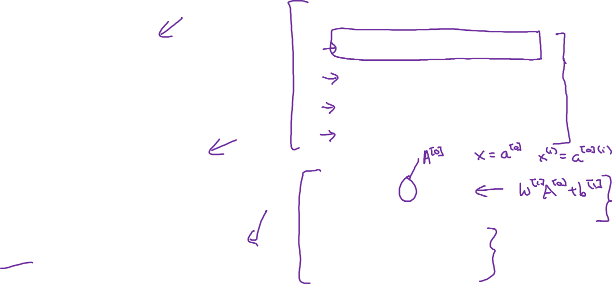





Recap of vectorizing across multiple examples
for i = 1 to m
$$x_{1}$$
$$z^{\left[1\right](i)}=W^{\left[1\right]}x^{(i)}+b^{\left[1\right]}$$
$$x_{2}$$
$$\hat{y}$$
$$x_{3}$$
$$a^{\left[1\right](i)}=σ(z^{\left[1\right]\left(i\right)})$$
$$z^{\left[2\right](i)}=W^{\left[2\right]}a^{\left[1\right](i)}+b^{\left[2\right]}$$
$$a^{\left[2\right](i)}=σ(z^{\left[2\right]\left(i\right)})$$
$$X=$$
$$x^{(1)}$$
$$x^{(2)}$$
…
$$x^{(m)}$$
$$Z^{\left[1\right]}=W^{\left[1\right]}X+b^{\left[1\right]}$$
$$A^{\left[1\right]}=σ(Z^{\left[1\right]})$$
$$Z^{\left[2\right]}=W^{\left[2\right]}A^{\left[1\right]}+b^{\left[2\right]}$$
$A^{[1]}=$
$$a^{[1](1)}$$
$$a^{[1](2)}$$
$$a^{[1](m)}$$
…
$$A^{\left[2\right]}=σ(Z^{\left[2\right]})$$
Notes:
Here we are showing In a bit cleaner way, the top right part shows what we will be doing in a for loop for m examples.
For each example, we are computing z values & a values for each layer, than we are doing the same for the 2nd layer. These 2 formulas are the crux of neural networks.
Now instead of doing this in a for loop we can do this in vectorized fashion as shown previously as well. We take our weight matrix in right order, matrix multiply it with the X matix, this will get us A matrix where each column represents the activation associated with each example.
Now, see the pattern here, these A matrix will just become the input to the next layer.
These A, Z, X matrices have similar dimesnions as well. Where columns represents the examples, & rows represents features, nodes or whatever you wanna call them,

